Slide 1


Asian Ventures in NYC

Slide 2
Investing in Asian businesses in NYC
NYC is the Top 7th most visited city in the world
Asian food (namely Chinese, Japanese, Korean and Indian) seem to be welcomed
by locals and tourists
Asians living in or travelling to NYC would feel a sense of belonging, seeing fellow
country people, or eating their cuisines.
- Introduce Asian cultures and cuisines to NYC locals

Slide 3
Data Acquisition
Neighborhoods with their geographical coordinates per Borough from
Foursquare API
- Cleaned data to only contain neighborhoods with Asian businesses.
Statistics of international tourists expenditure from NYC Travel & Tourism
Trend Report 2019
Statistics of international tourists in NYC (2013-2018) from Baruch College

Slide 4
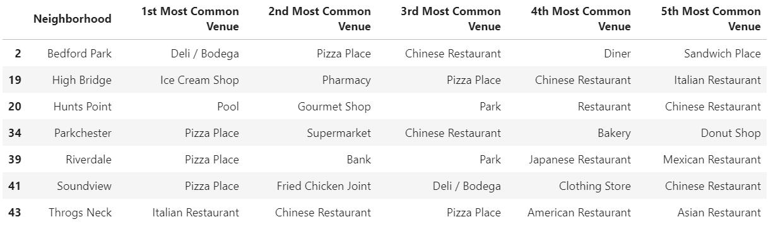
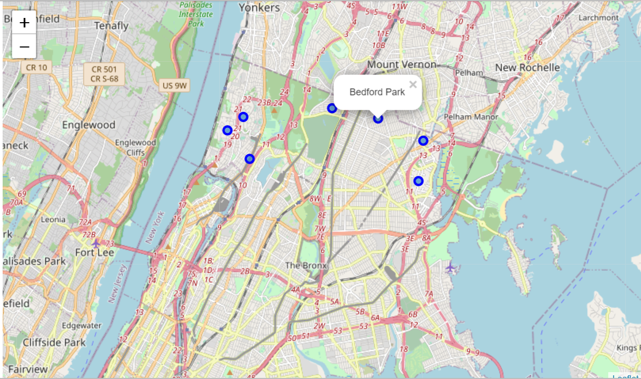
Bronx

Slide 5
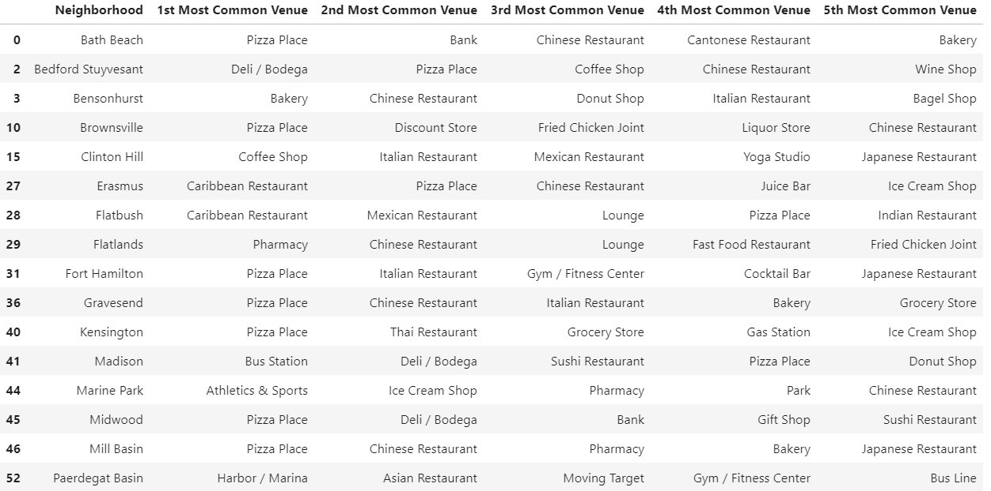
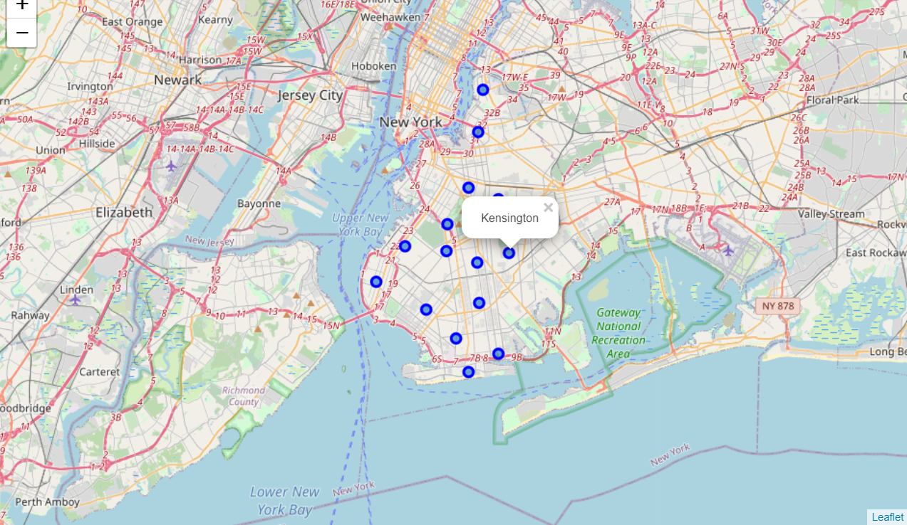
Brooklyn

Slide 6
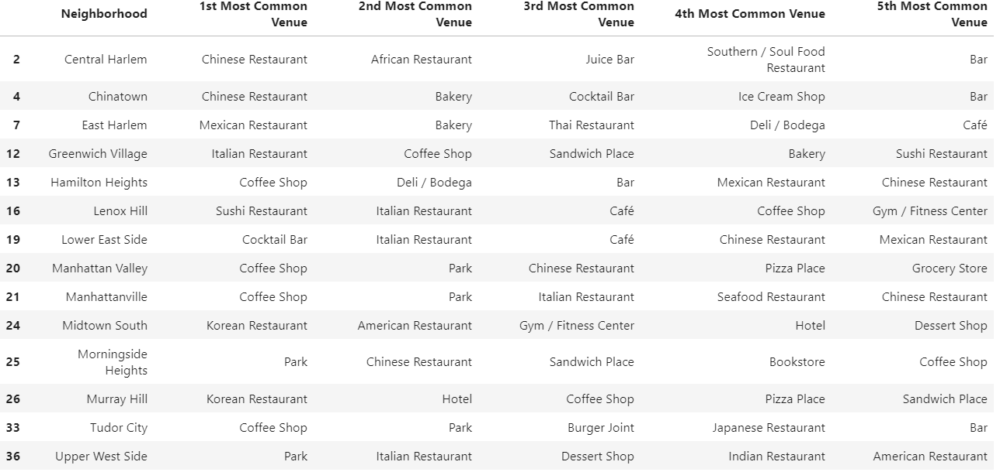
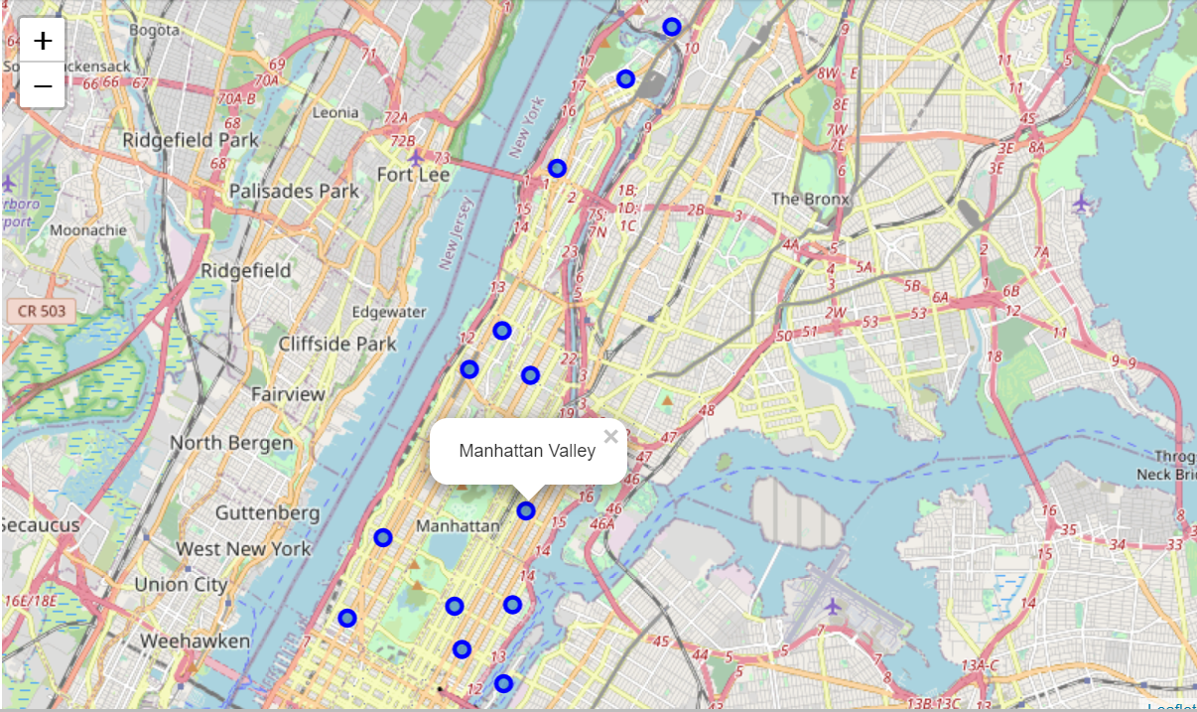
Manhattan

Slide 7
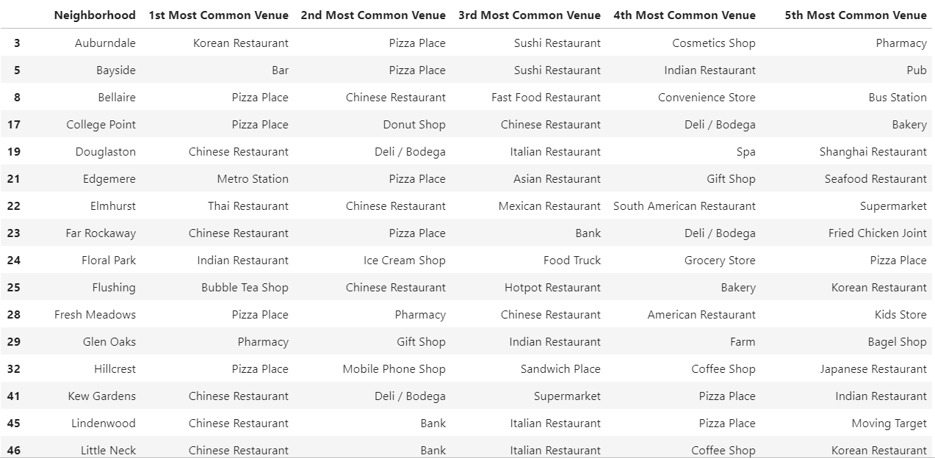
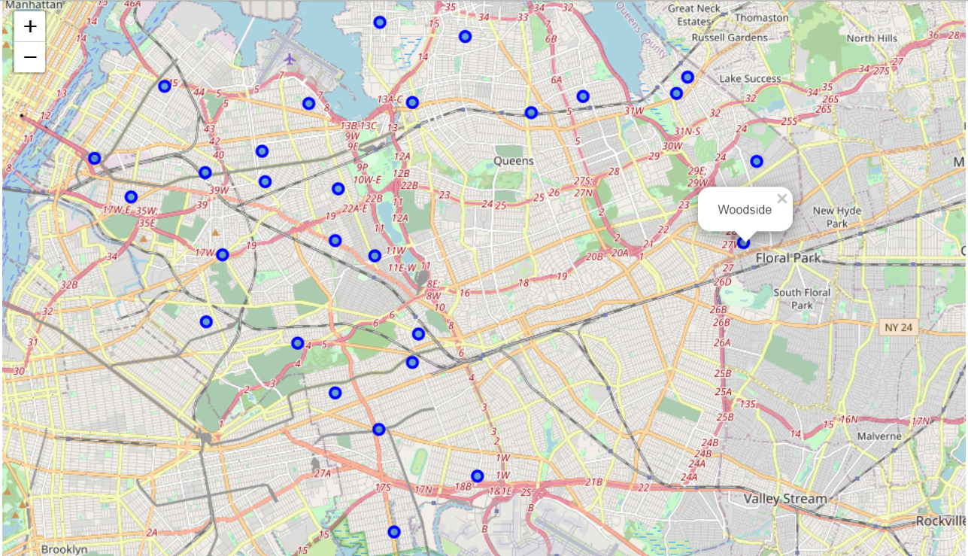
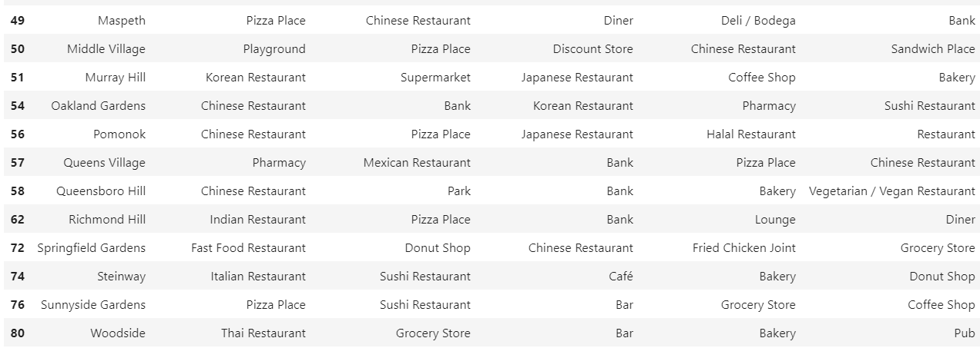
Queens

Slide 8
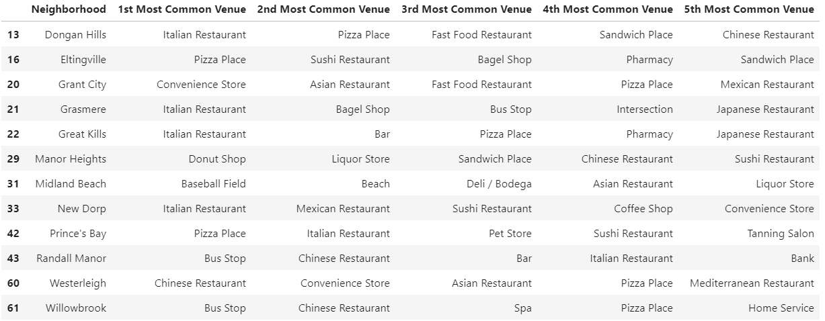
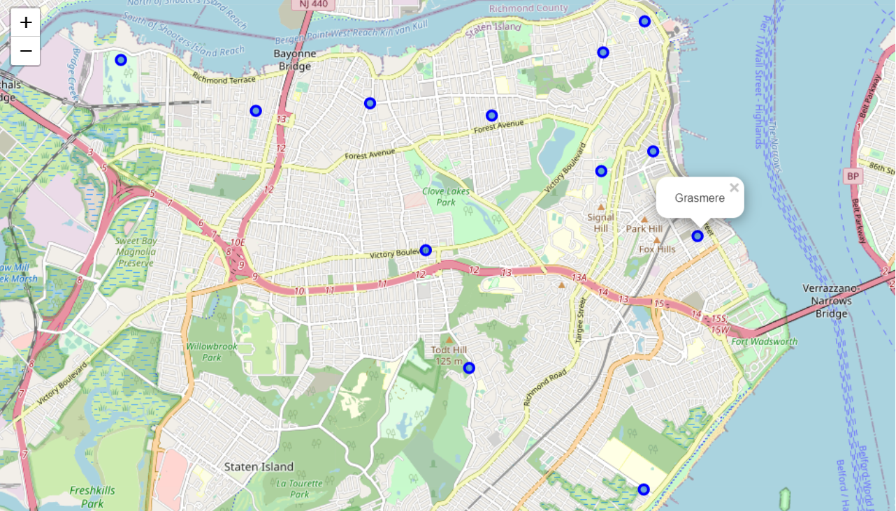
Staten Island

Slide 9
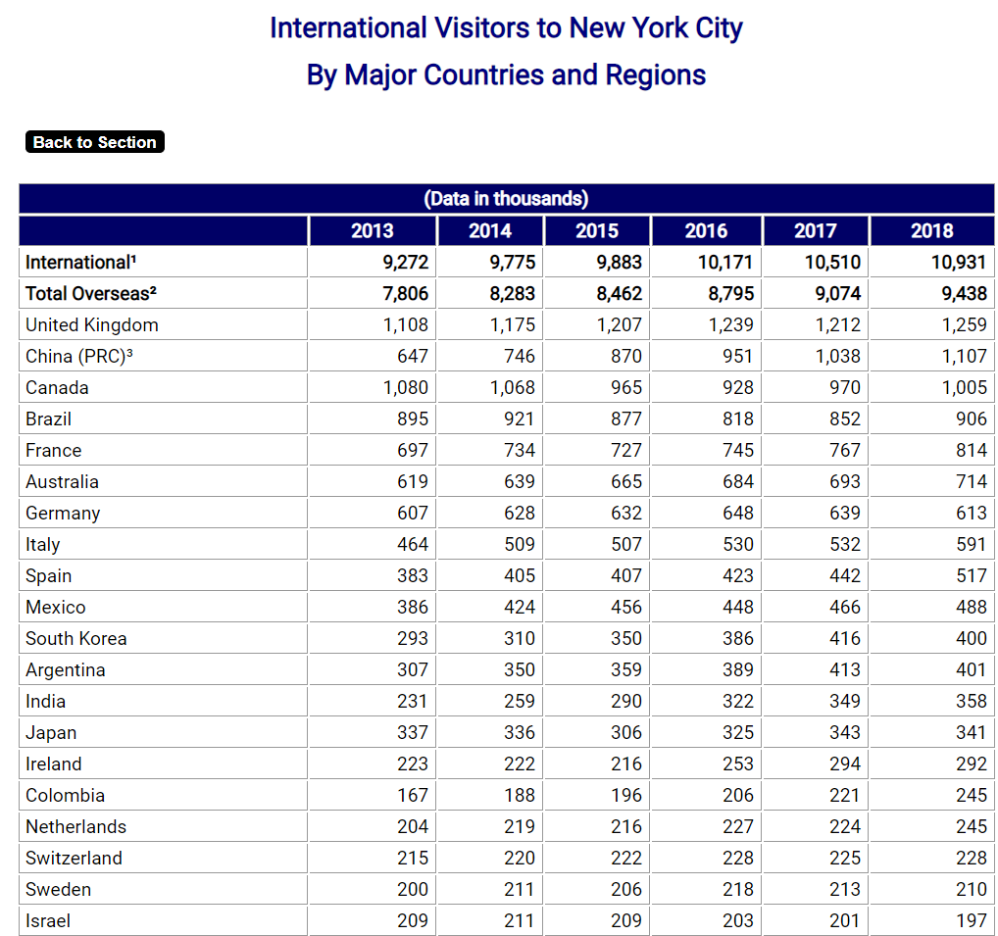
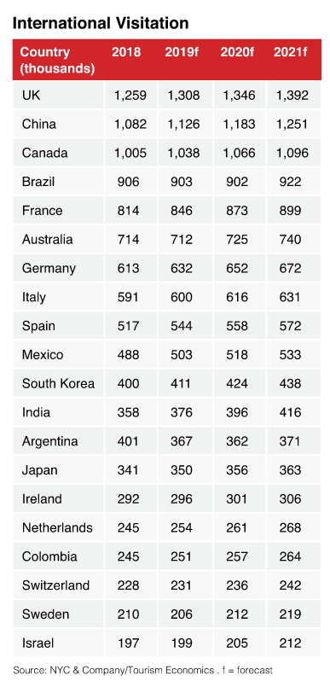
International tourists

Slide 10
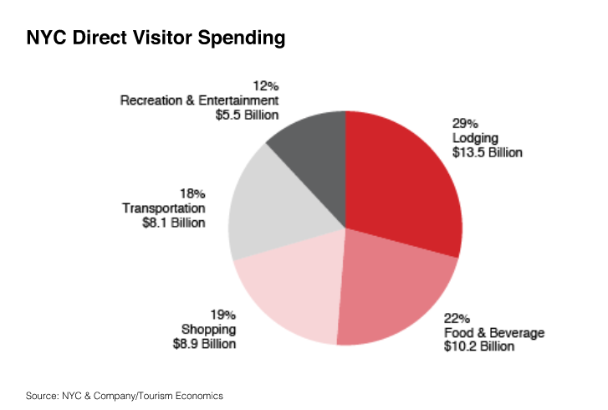
International Tourist Expenditure
Lucrative to invest in

Slide 11
Conclusion
Tidied up data sets for investors to spot neighborhoods wisely at one glance
More could be told about each neighborhood
- Distribution of age population (Eg. If youth > elderly, can consider modern fusion cuisines.)
- Mean of the income groups (Eg. To build a café or high-end restaurant.)

